Slide 1
Identity and Inclusion of Immigrant Children
Muhammed Emin Kizilkaya, PhD
Saeed Shamshirian, PhD

Slide 2
Identity Formation and Group Influence
Identity is fluid and hybrid; it is not fixed but shaped through social interactions.
A well-formed group plays a crucial role in shaping the identity of immigrant children.
The group has its own “idio-culture” (shared norms, values, and practices). Positive group dynamics can provide a sense of belonging and create fertile ground to guide individuals toward integration.
The group functions as a “hinge” facilitating the transmission of collective macro-culture into individual micro-character.

Slide 3
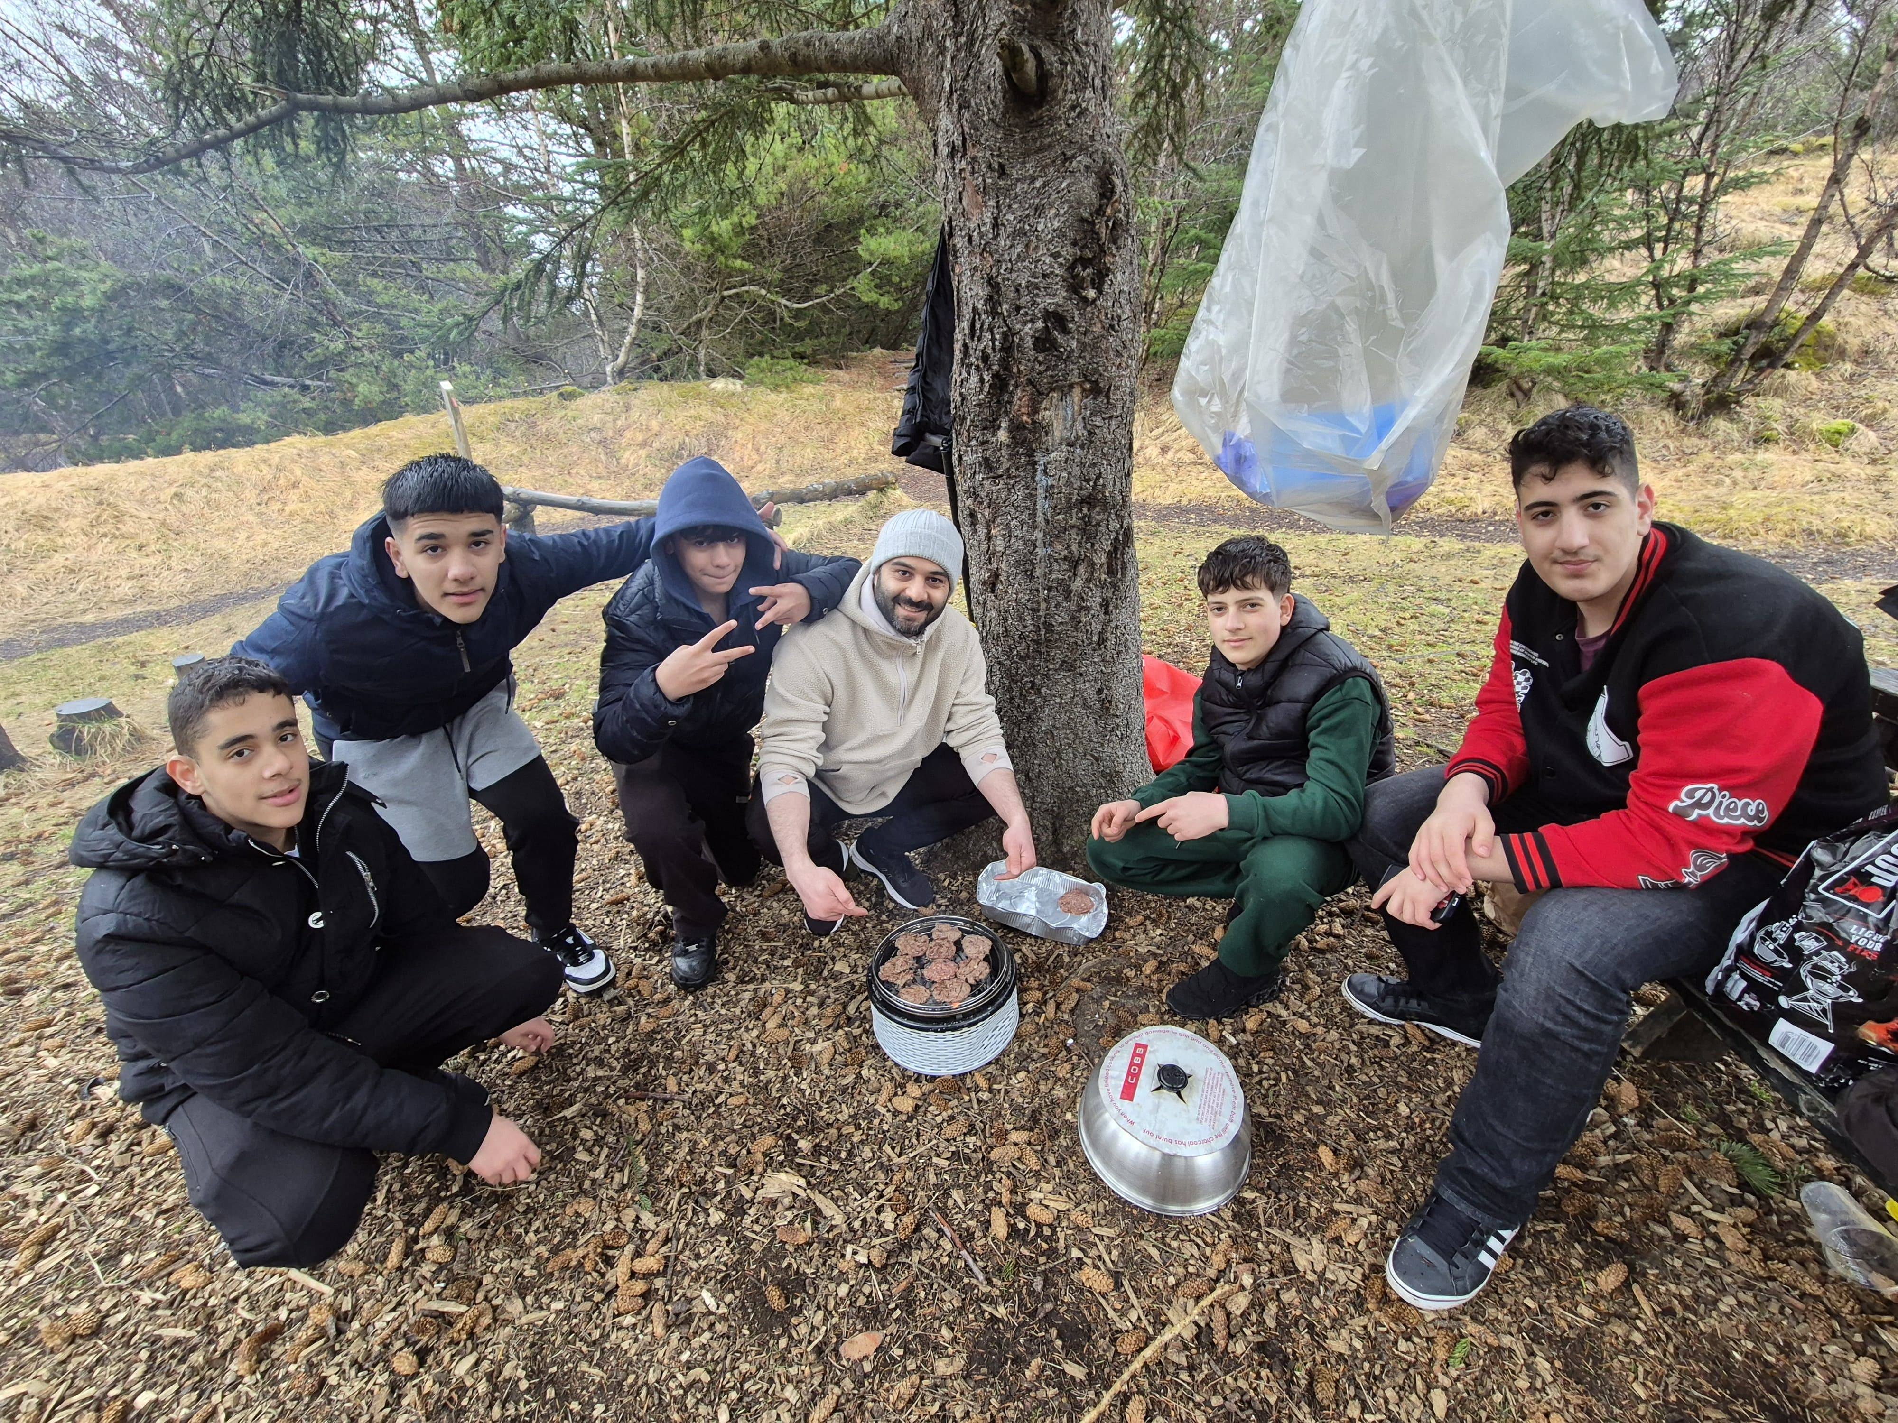





Better Group, Better Society
Being in the group
Belonging to the group
Building and Battling group
Bonding by group
Bridging group

Slide 4
The First Days (Being and Belonging)
High energy and dominance in group interactions
Frequent interruptions and attention-seeking behavior
Lack of discipline and testing of boundaries
Overlapping conversations and leadership struggles
Challenging authority and group structure - Mentors had to step in and regain control (“we took over”)

Slide 5
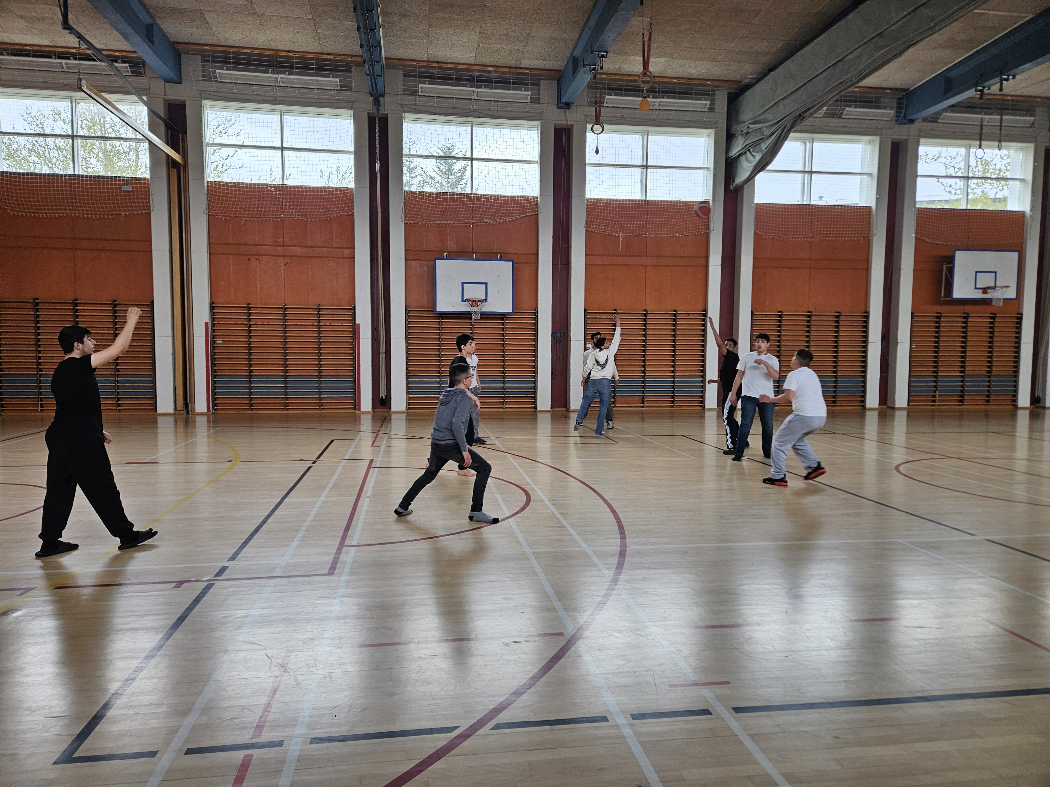

The First Days (Being and Belonging)
Empowering dominant members as peer leaders to build consensus and responsibility
Strengthening connections with parents and encouraging aspirations and positivity about their children
Embedding a sense of “we” instead of “me”
Promoting the benefits of group membership through unstructured play

Slide 6
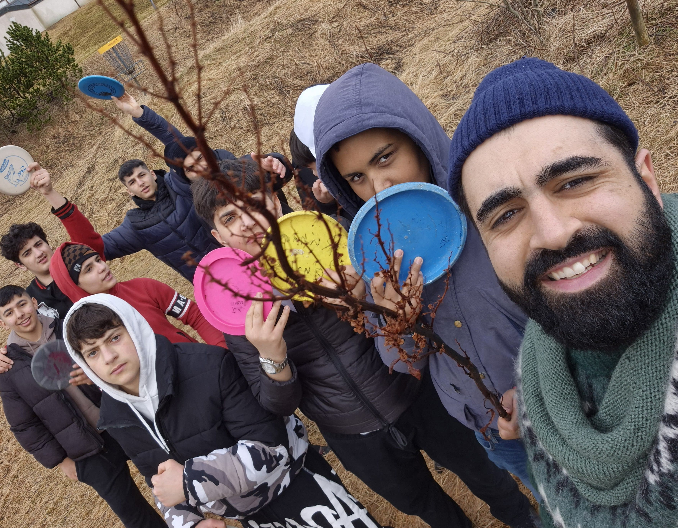







The Following Days (Belonging and Building)
Positive social support and emotional control
Emphasizing trust-building
Diminishing “Doctor-patient” role. Being down on their levels (using slangs, cross-cultural jokes etc)
Experimentation without judgement (problem-finding and problem-solving
Empowering their dreams and expanding their vision

Slide 7
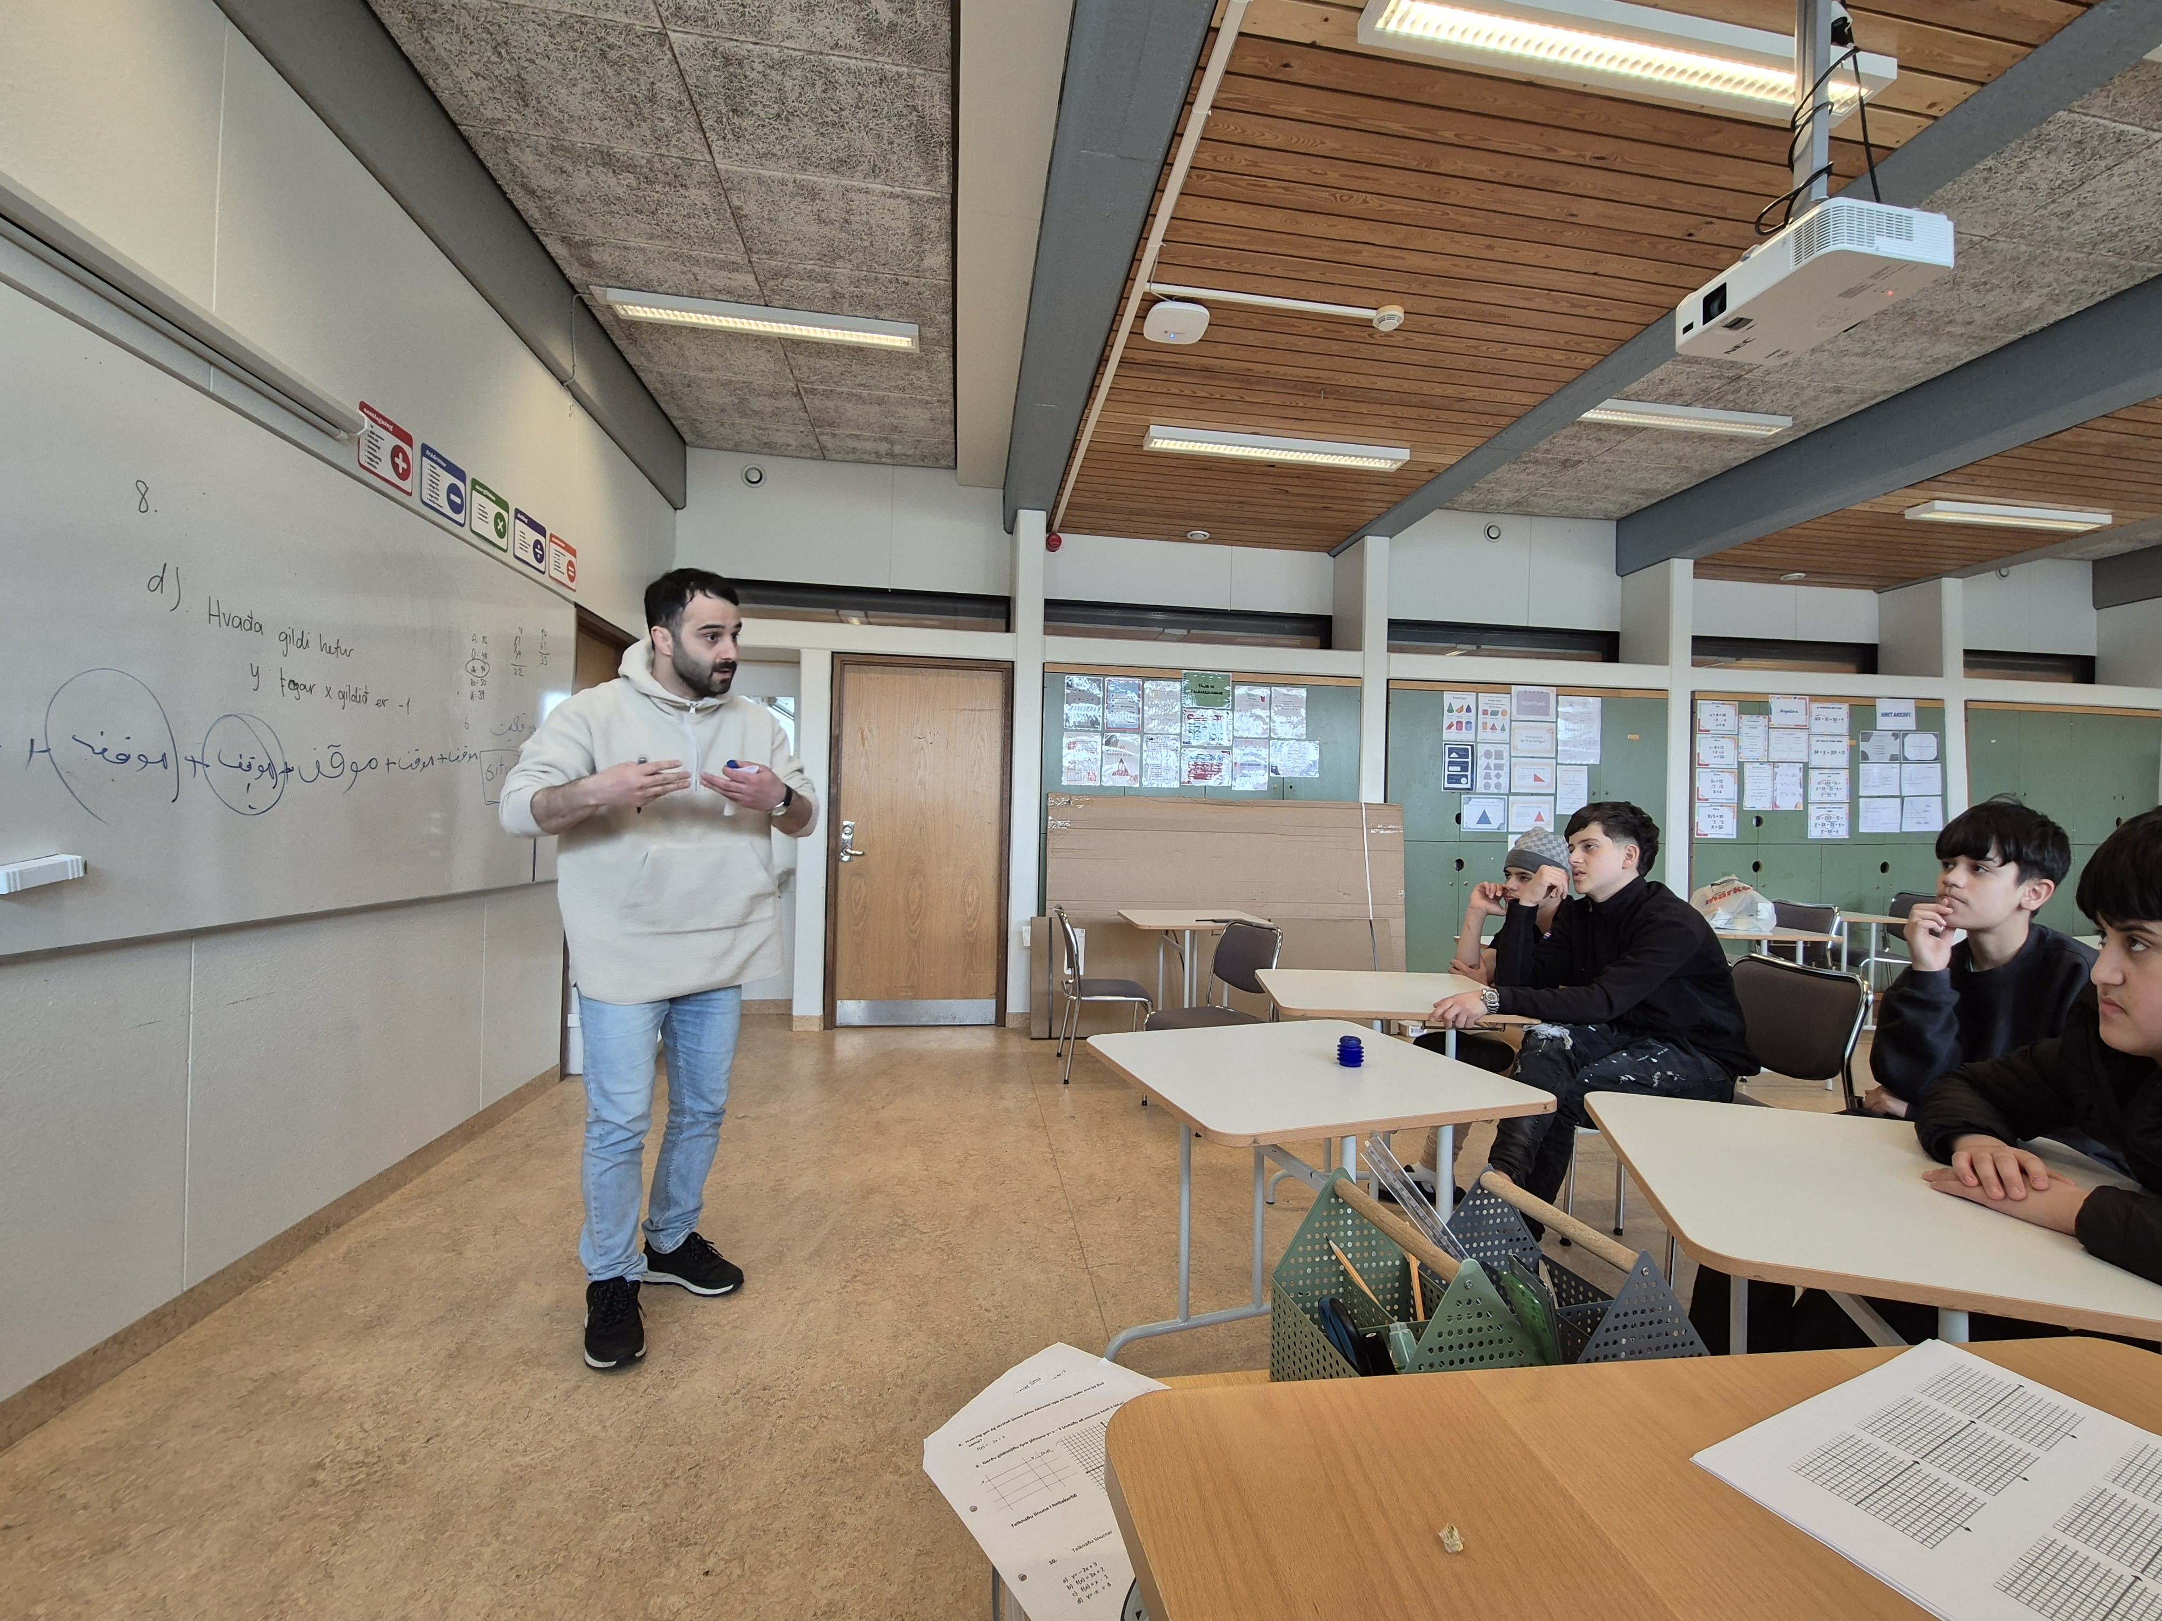




Recent Days (Building and Battling)
They want to protect what they have built.
Strong friendships are forming, with students challenging each other’s behavior and loyalty.
They are engaging in self-reflection and recognizing their own difficulties.
Building/battling moments -> collectively (example)
Implementing structured teaching to the unstructured play
They feel comfortable challenging the mentors as well.

Slide 8
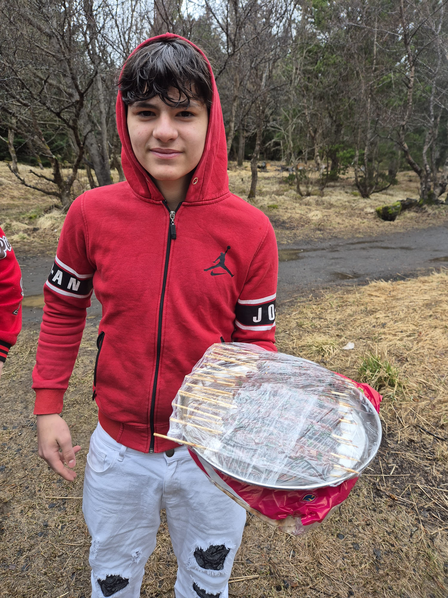
Recent Days (Battling and Bonding)
Direct observations.
Positive feedback has been received from the school administration and teachers have reported notable improvements despite setbacks.
Students are showing better self-discipline (e.g., leaving their phones with the school principal before entering class).
Students are sharing good deeds they’ve done during the week based on the tasks given to them.
Occasional setbacks occur, but they work through them together.

Slide 9
Future? Bonding and Bridging
A group that not only thrives internally but creates opportunities for others to thrive as well.
A community where former participants become mentors, guiding the next generation.
A lasting cultural shift in the school, where students feel empowered, connected, and capable of making a difference.
In other words…
Encourage. Build. Community. Sustain.

Slide 10
Recommendation and Future Directions
Expand social inclusion programs
Provide financial and logistic support for recruitment
Strengthen collaboration between school and community partners – especially local minority leaders
Invest in hybrid mentors

